Slide 1
LLM FINETUNING
Konstantin Preußer

Slide 2
Table of Contents
Introduction to Fine-Tuning
Models
Code
Text Classification on GoEmotion
Text Classification on DB Pedia 14
Limitations
Conclusion

Slide 3
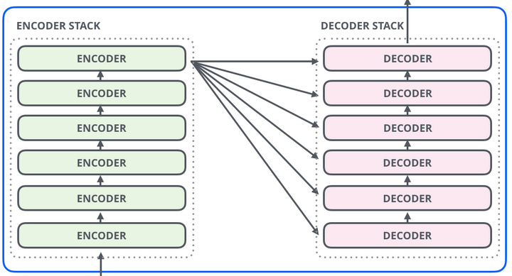
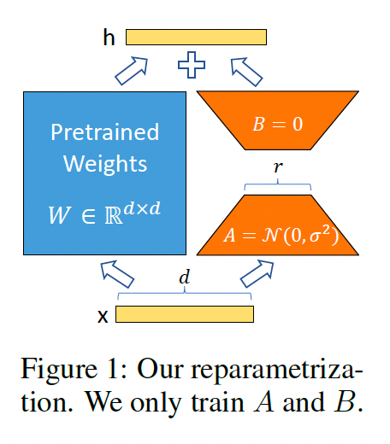
Fine-Tuning
Re-train / Improve Model Weights for specific Tasks
LoRa / QLoRa

Slide 4
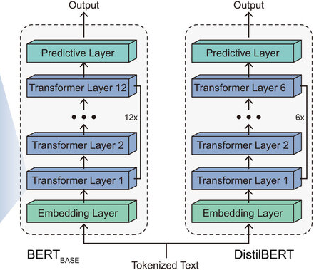
Models
Model < Memory / 12
-> 24GB Memory -> Model less than 2GB
DistilBERT - 66M Params (750 MB)
MiniLM - 22M Params (100 MB)

Slide 5

Code
Import Dataset from Huggingface
Load Model and Tokenizer with Transformers

Slide 6

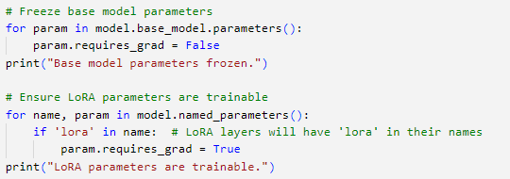
Code
Add LoRa to the Model with the PEFT-Library
Freeze Model and Unfreeze Trainable Parameters

Slide 7
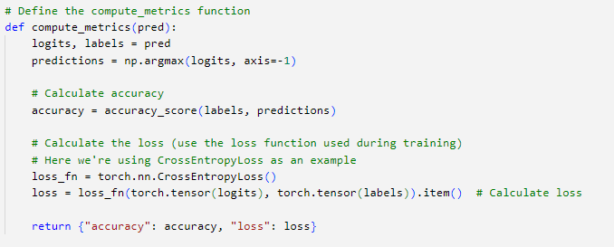
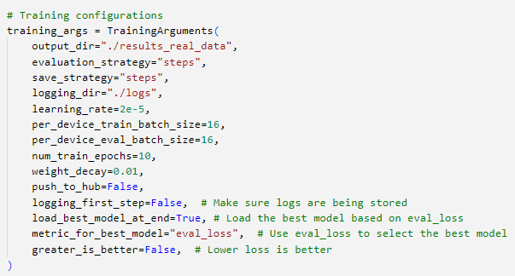
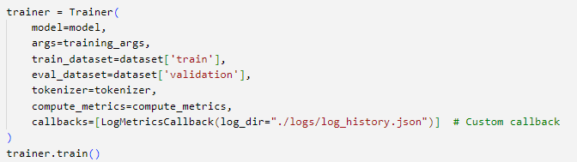
Code
Define Compute Metrics
Define Training Arguments
Build Trainer and Run Training

Slide 8
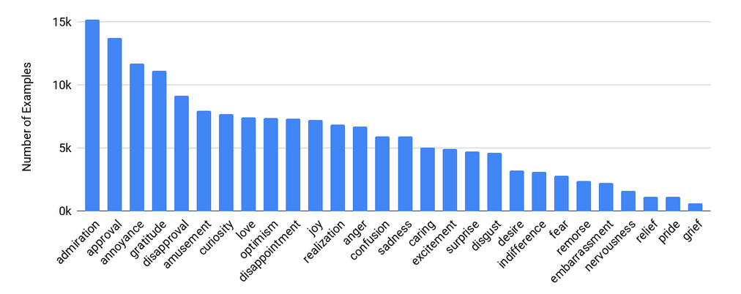
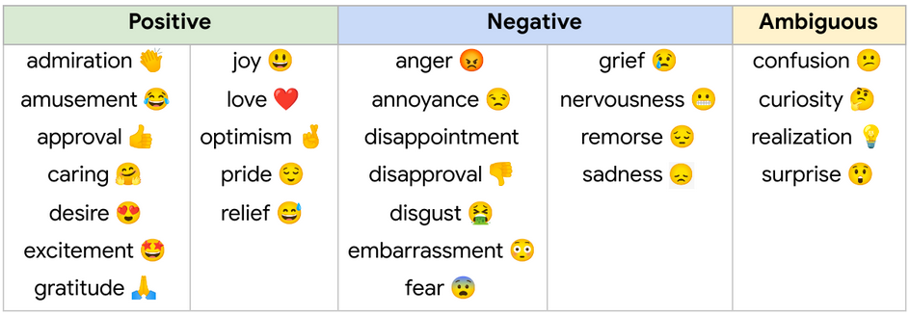
GoEmotion
Text Classification
27 (+1) emotions
58k curated comments
80/10/10 Split

Slide 9
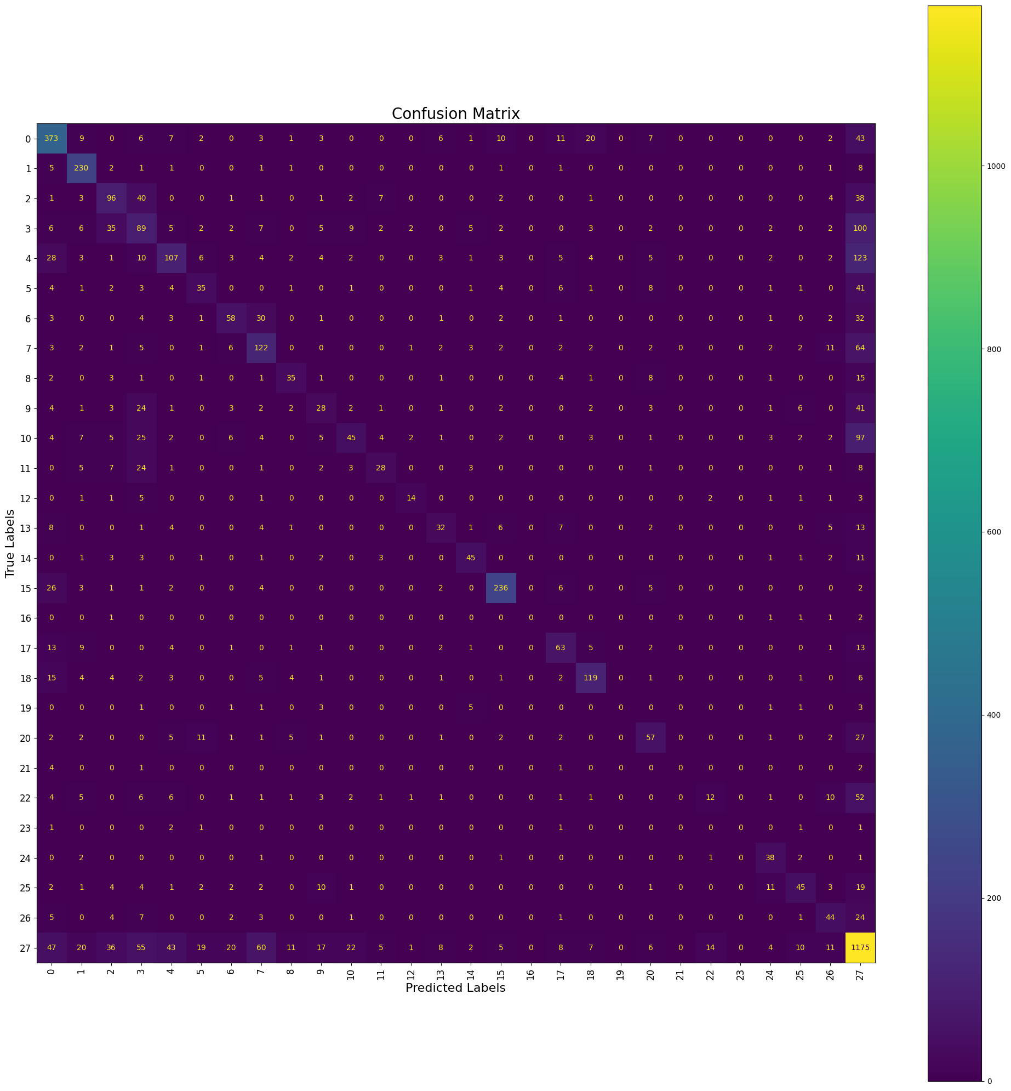
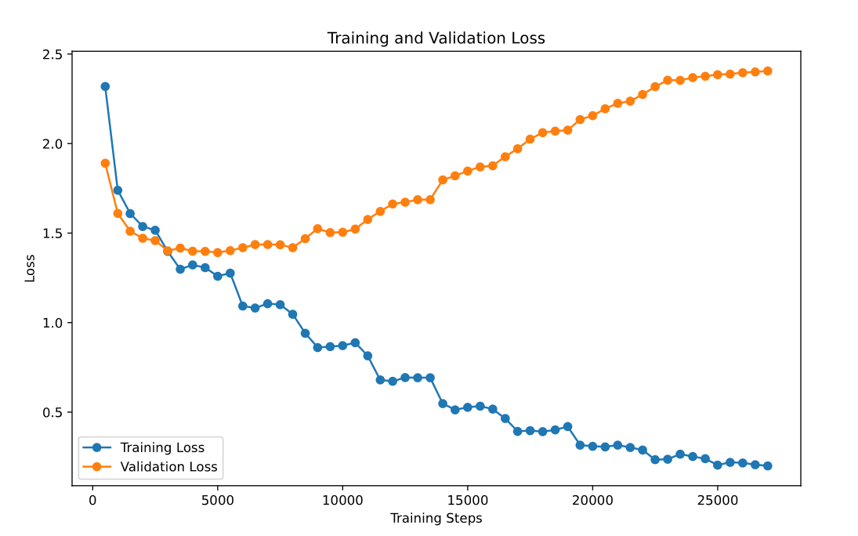
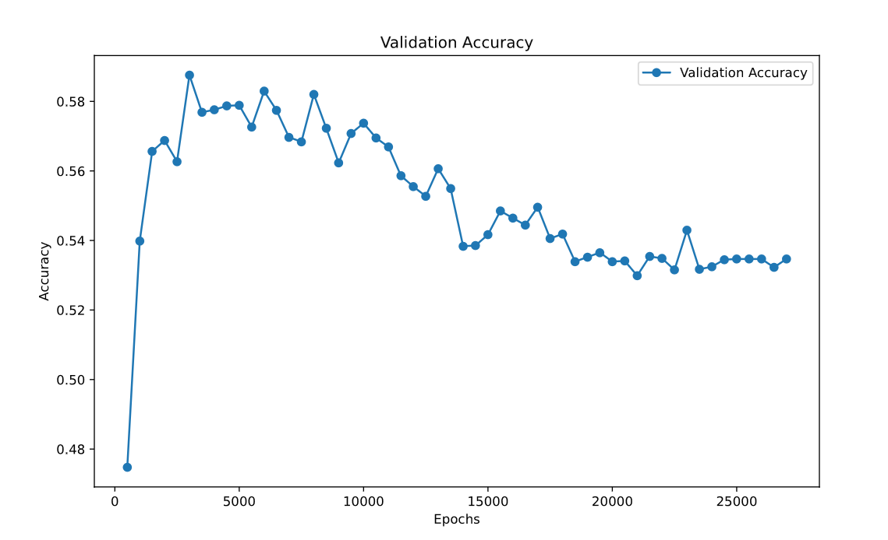
Results DistilBERT
Annoyance / Acceptance
- Yep, you can go around crashing into things and run people over and completely get away with it.
Batch 16
Finetuning last 2 Layers
Test accuracy = 58%

Slide 10
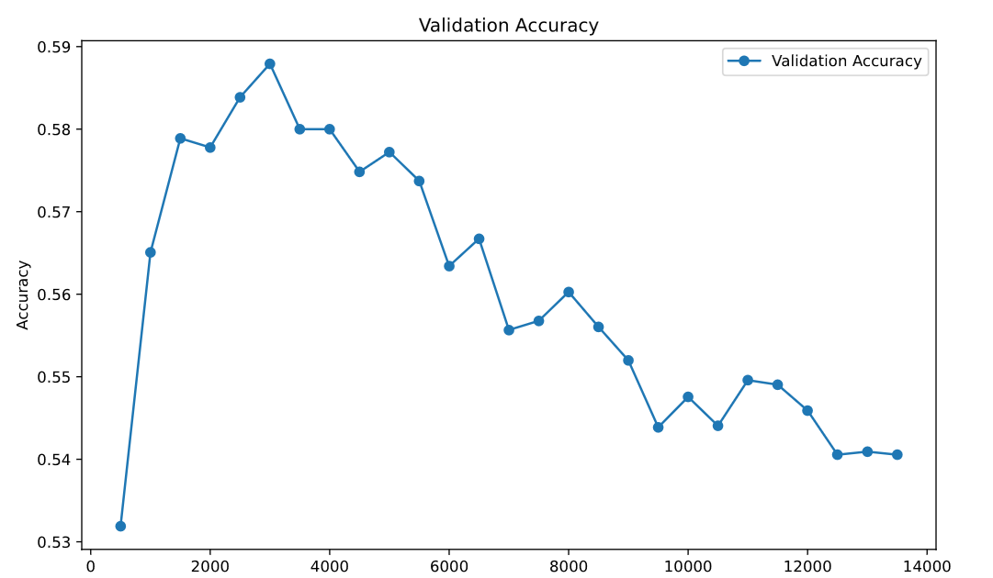
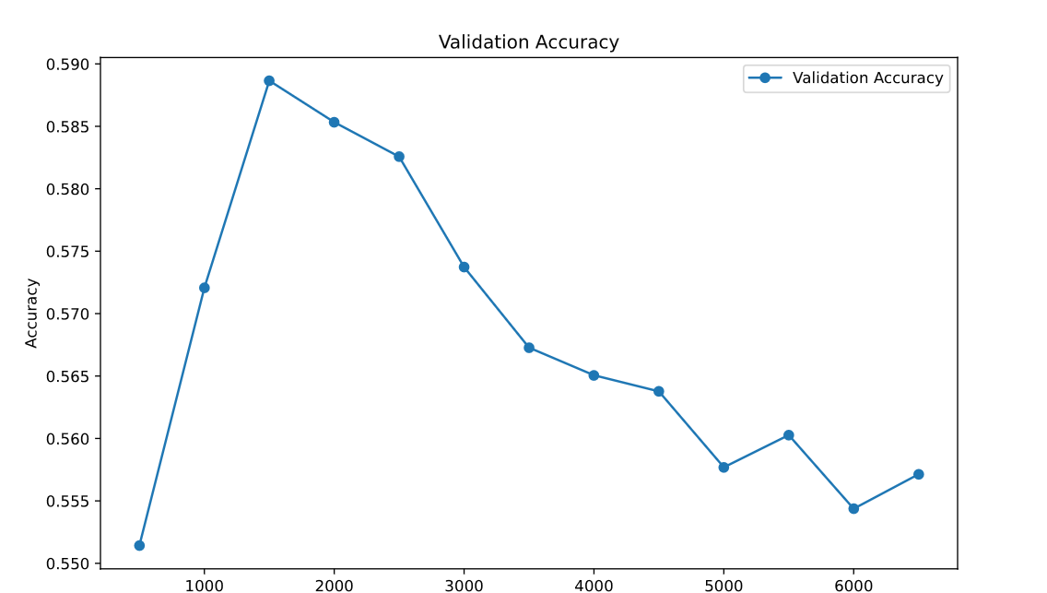
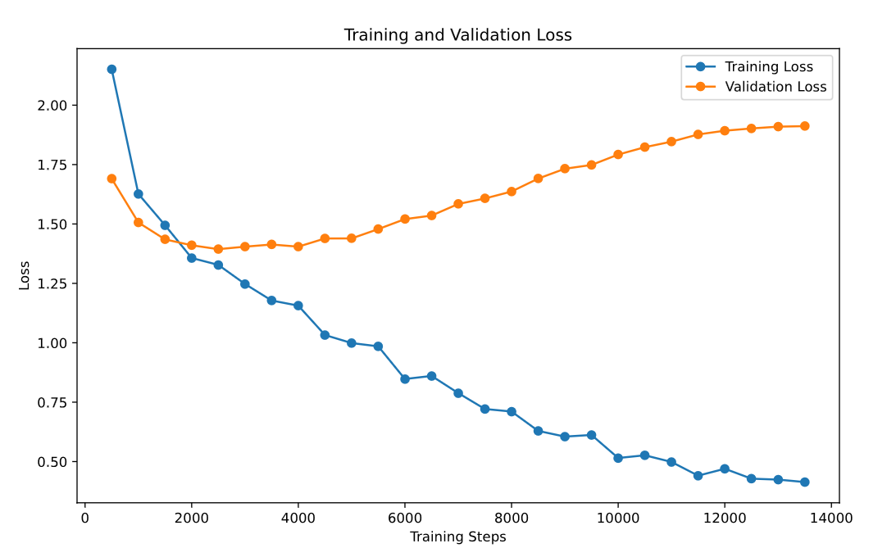
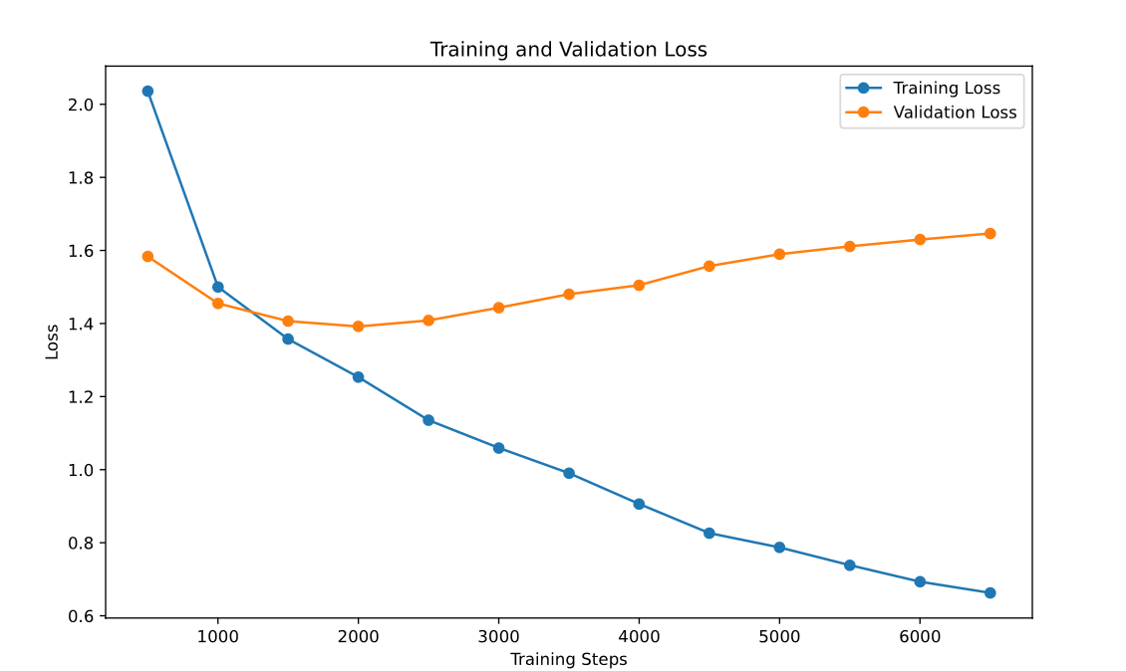
Results DistilBERT
Batch of 32
Batch of 64

Slide 11
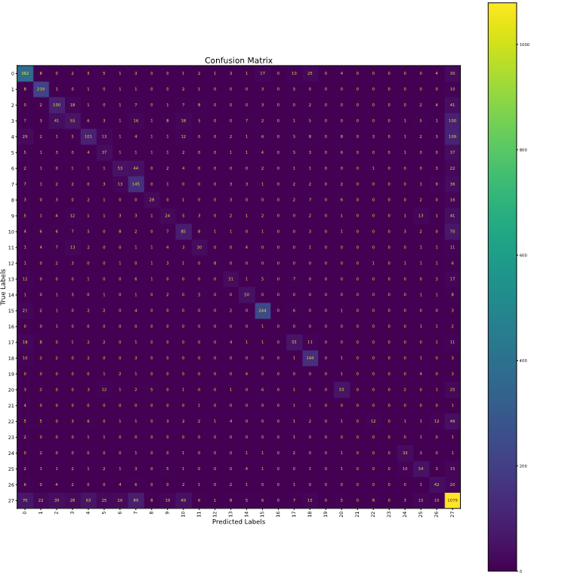
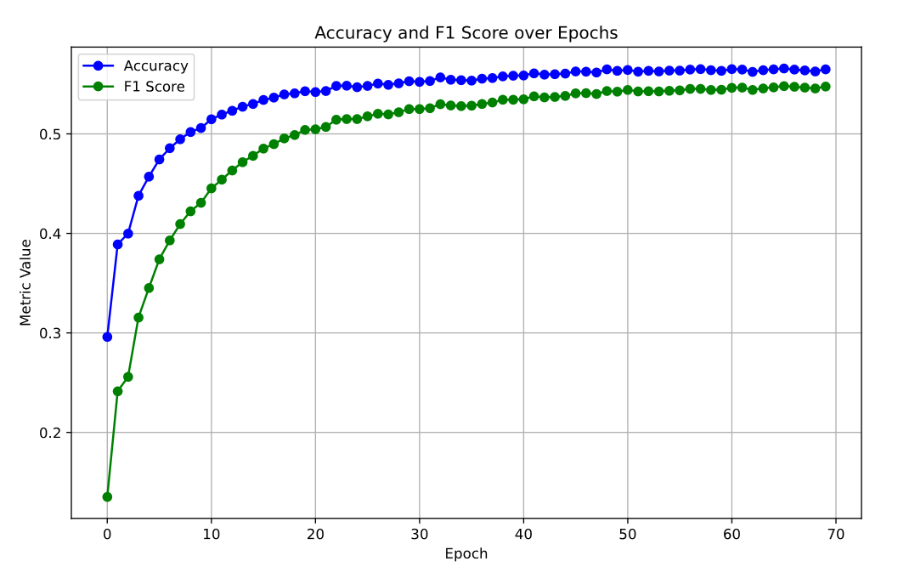
Results DistilBERT with LoRa
Batch Size = 64
LoRa Parameters( r=16, alpha=32)
No Overfitting

Slide 12
Comparison
Model | Test Accuracy
DistilBERT c. Finetuning(16 Batch) | 58.5%
DistilBERT c. Finetuning(32 Batch) | 58.7%
DistilBERT c. Finetuning(64 Batch) | 58.8%
DistilBERT with LoRa (64 Batch) | 54%
No Overfitting

Slide 13
DB Pedia 14
0. Company
1. Educational Institution
2. Artist
3. Athlete
4. Office Holder
5. Mean of Transportation
6. Building
7. Natural Place
8. Village
9. Animal
10. Plant
11. Album
12. Film
13. Written Work
Text Classification
14 Categories
630k Samples (45k/Class)
Train/Test-Split 8/1

Slide 14
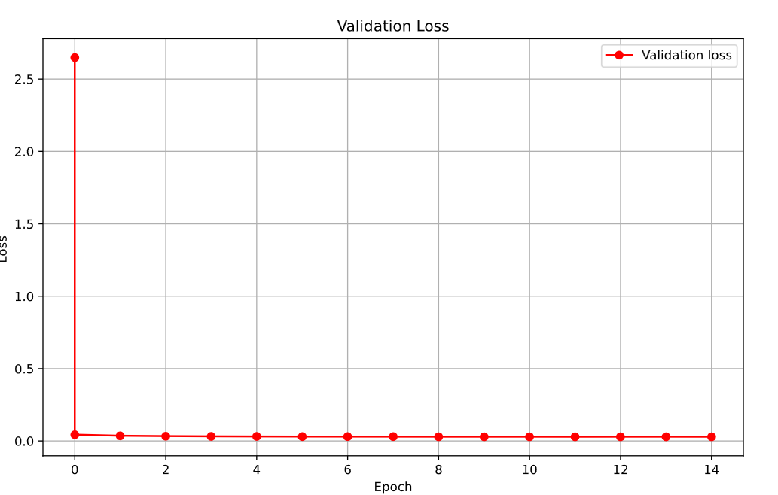
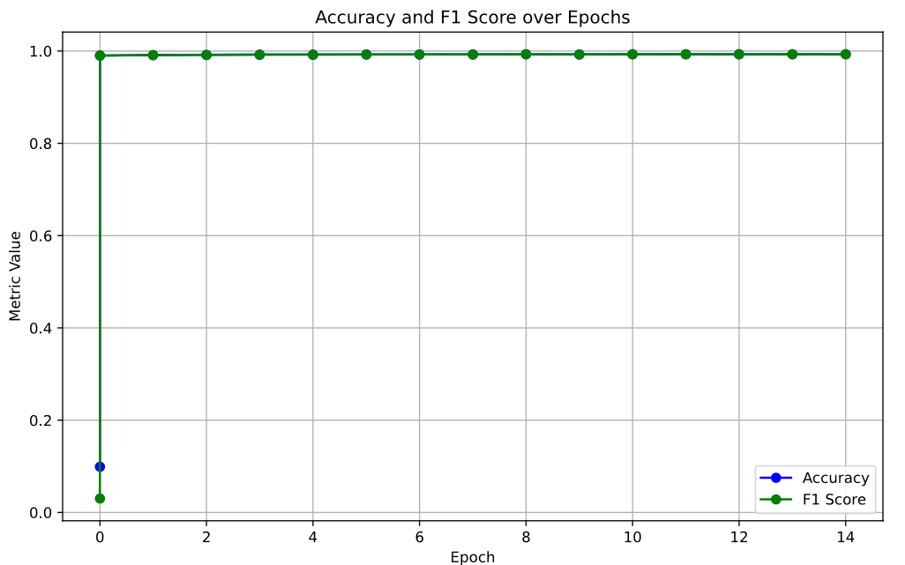
Results DistilBERT with LoRa
Batch Size = 64
LoRa Parameters( r=16, alpha=32)

Slide 15
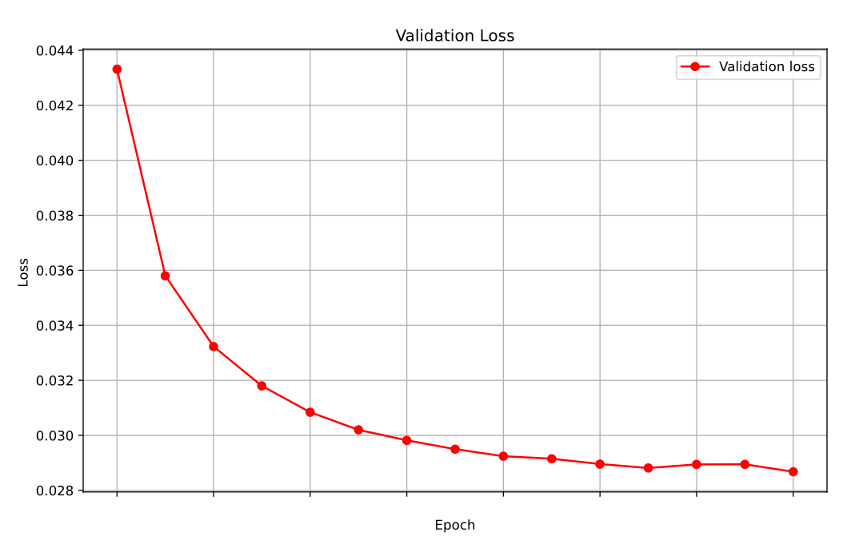
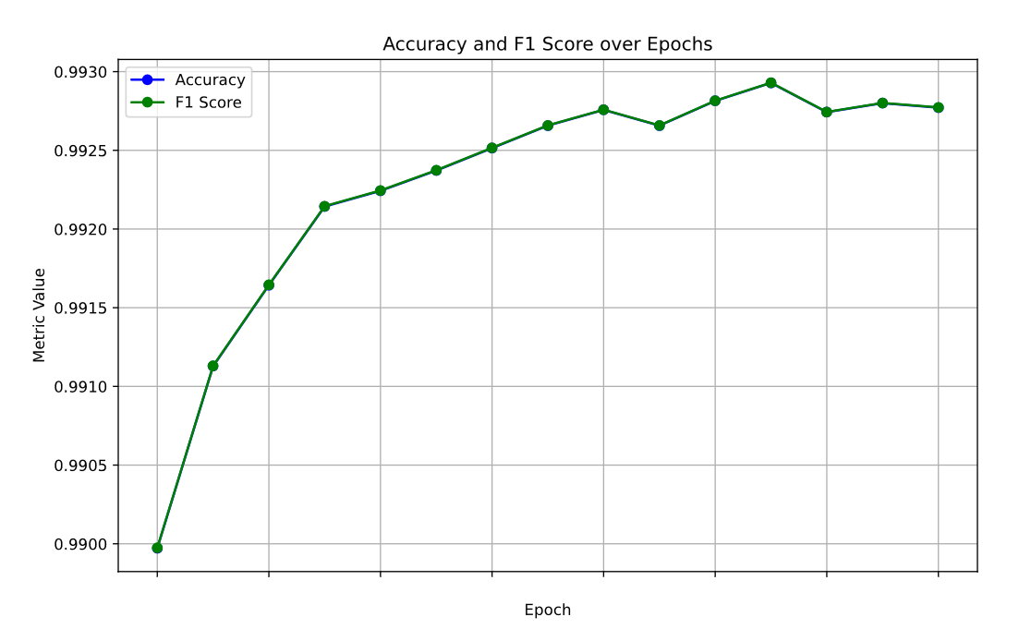
Results DistilBERT with LoRa
Batch Size = 64
LoRa Parameters( r=16, alpha=32)
1 3 5 7 9 11 13 15
1 3 5 7 9 11 13 15

Slide 16
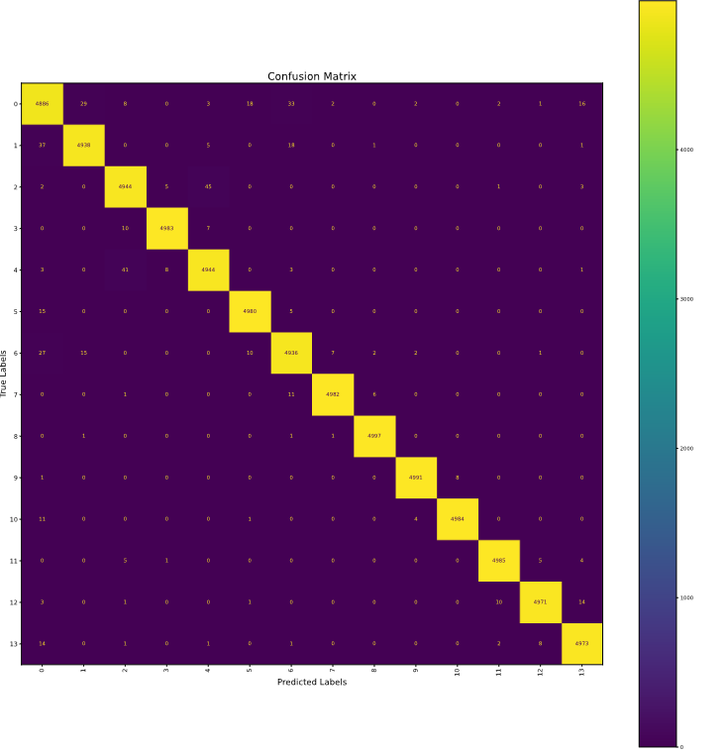
Results DistilBERT with LoRa
Batch Size = 64
LoRa Parameters( r=16, alpha=32)
1 3 5 7 9 11 13 15
1 3 5 7 9 11 13 15

Slide 17
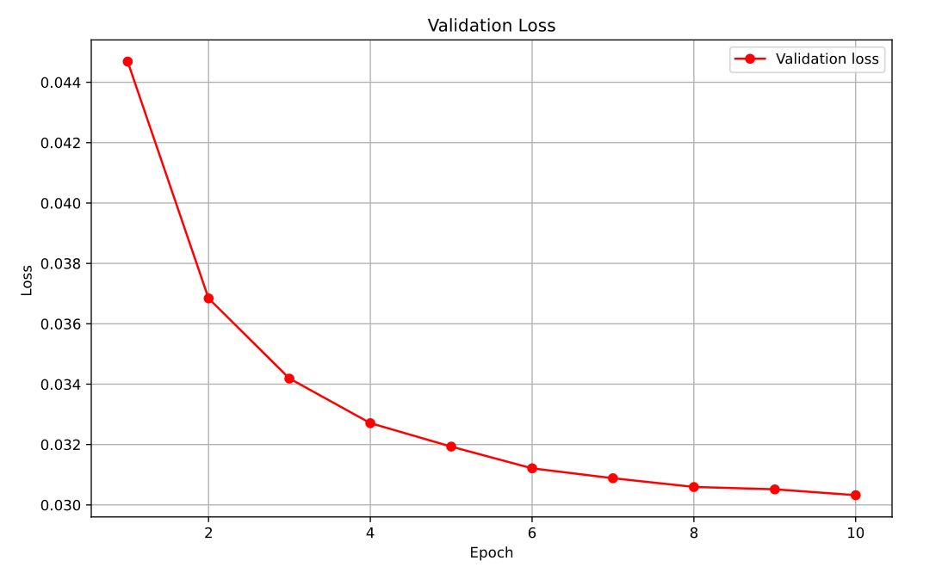
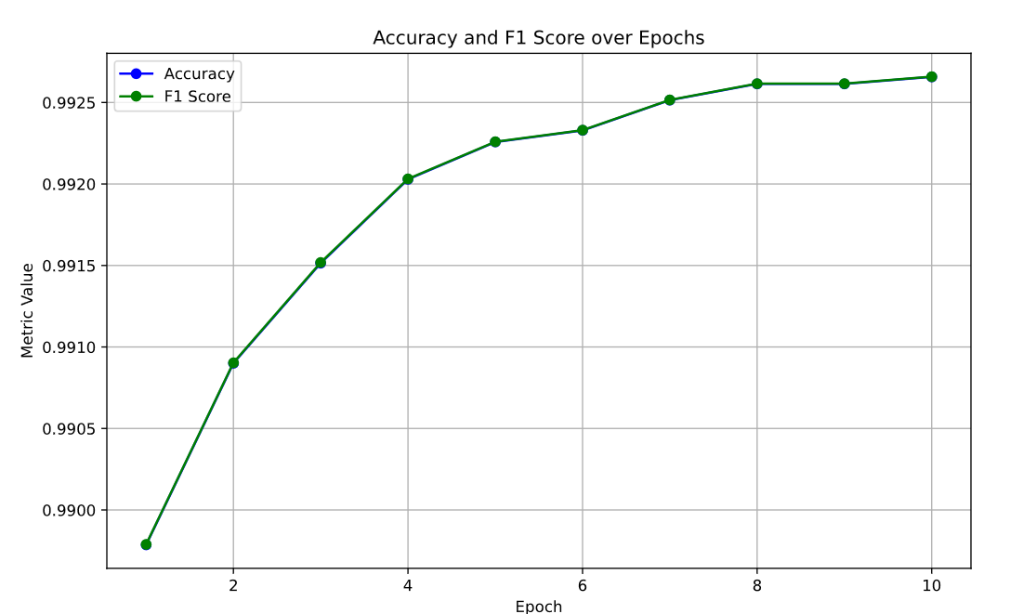
Results DistilBERT with LoRa
Batch Size = 64
LoRa Parameters( r=8, alpha=32)
1 3 5 7 9 11 13 15
1 3 5 7 9 11 13 15

Slide 18
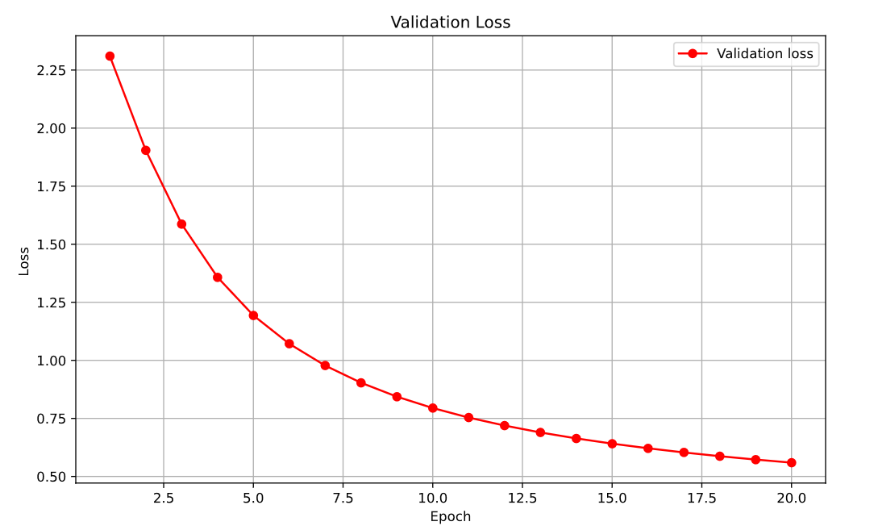
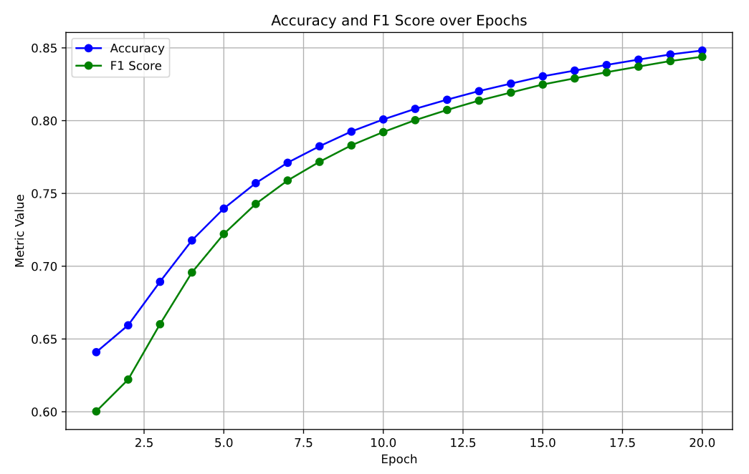
MiniLM with LoRa
Batch Size = 64
LoRa Parameters( r=8, alpha=32)

Slide 19
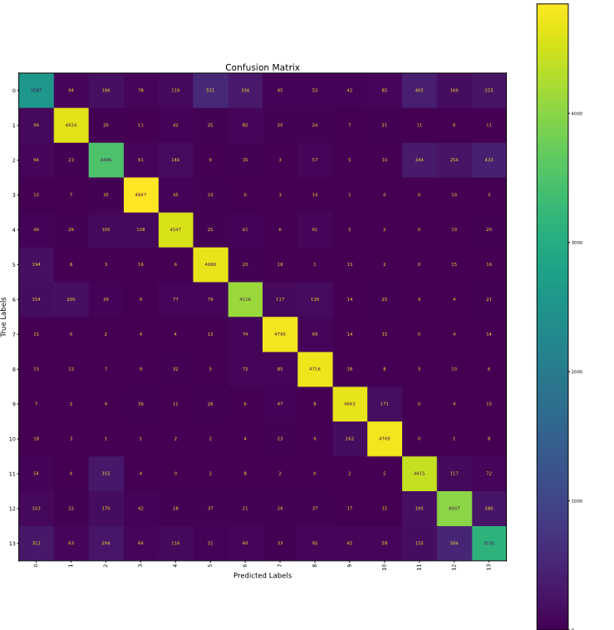
MiniLM with LoRa
Predict: 5 (Mean of Transportation) Actual: 0 (Company)
Nationale Regionale Transport is a domestic airline based in Libreville Gabon. Its main base is Libreville International Airport.The airline is on the list of air carriers banned in the European Union.

Slide 20
Comparison
Both models show impressive classification results
DistillBert reaches 99% Accuracy after 1 Epoch
MiniLM reache 85% Accuracy after 20 Epochs (possibly could improve more)

Slide 21
Limitations
Need for big computing power
Large amounts of new data needed
Modules are not very harmonic

Slide 22
Conclusion
Impressive results for complex text classification tasks
LoRa reaches very good results without Overfitting
Domain changes rapidly -> Libraries not in sync / up to date
Projects scale based on compute/money

